Slide 1
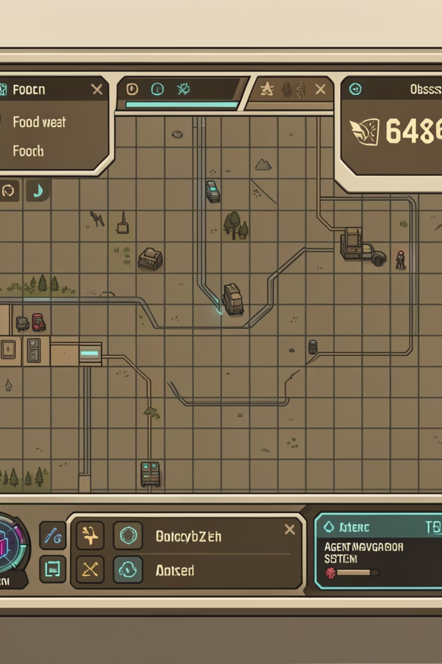
Project Proposal: Process Survival Game
Submitted to
Mam Wajeeha Fareed
Presented by
Muhammad Umer.
Date: January 27, 2026.

Slide 2
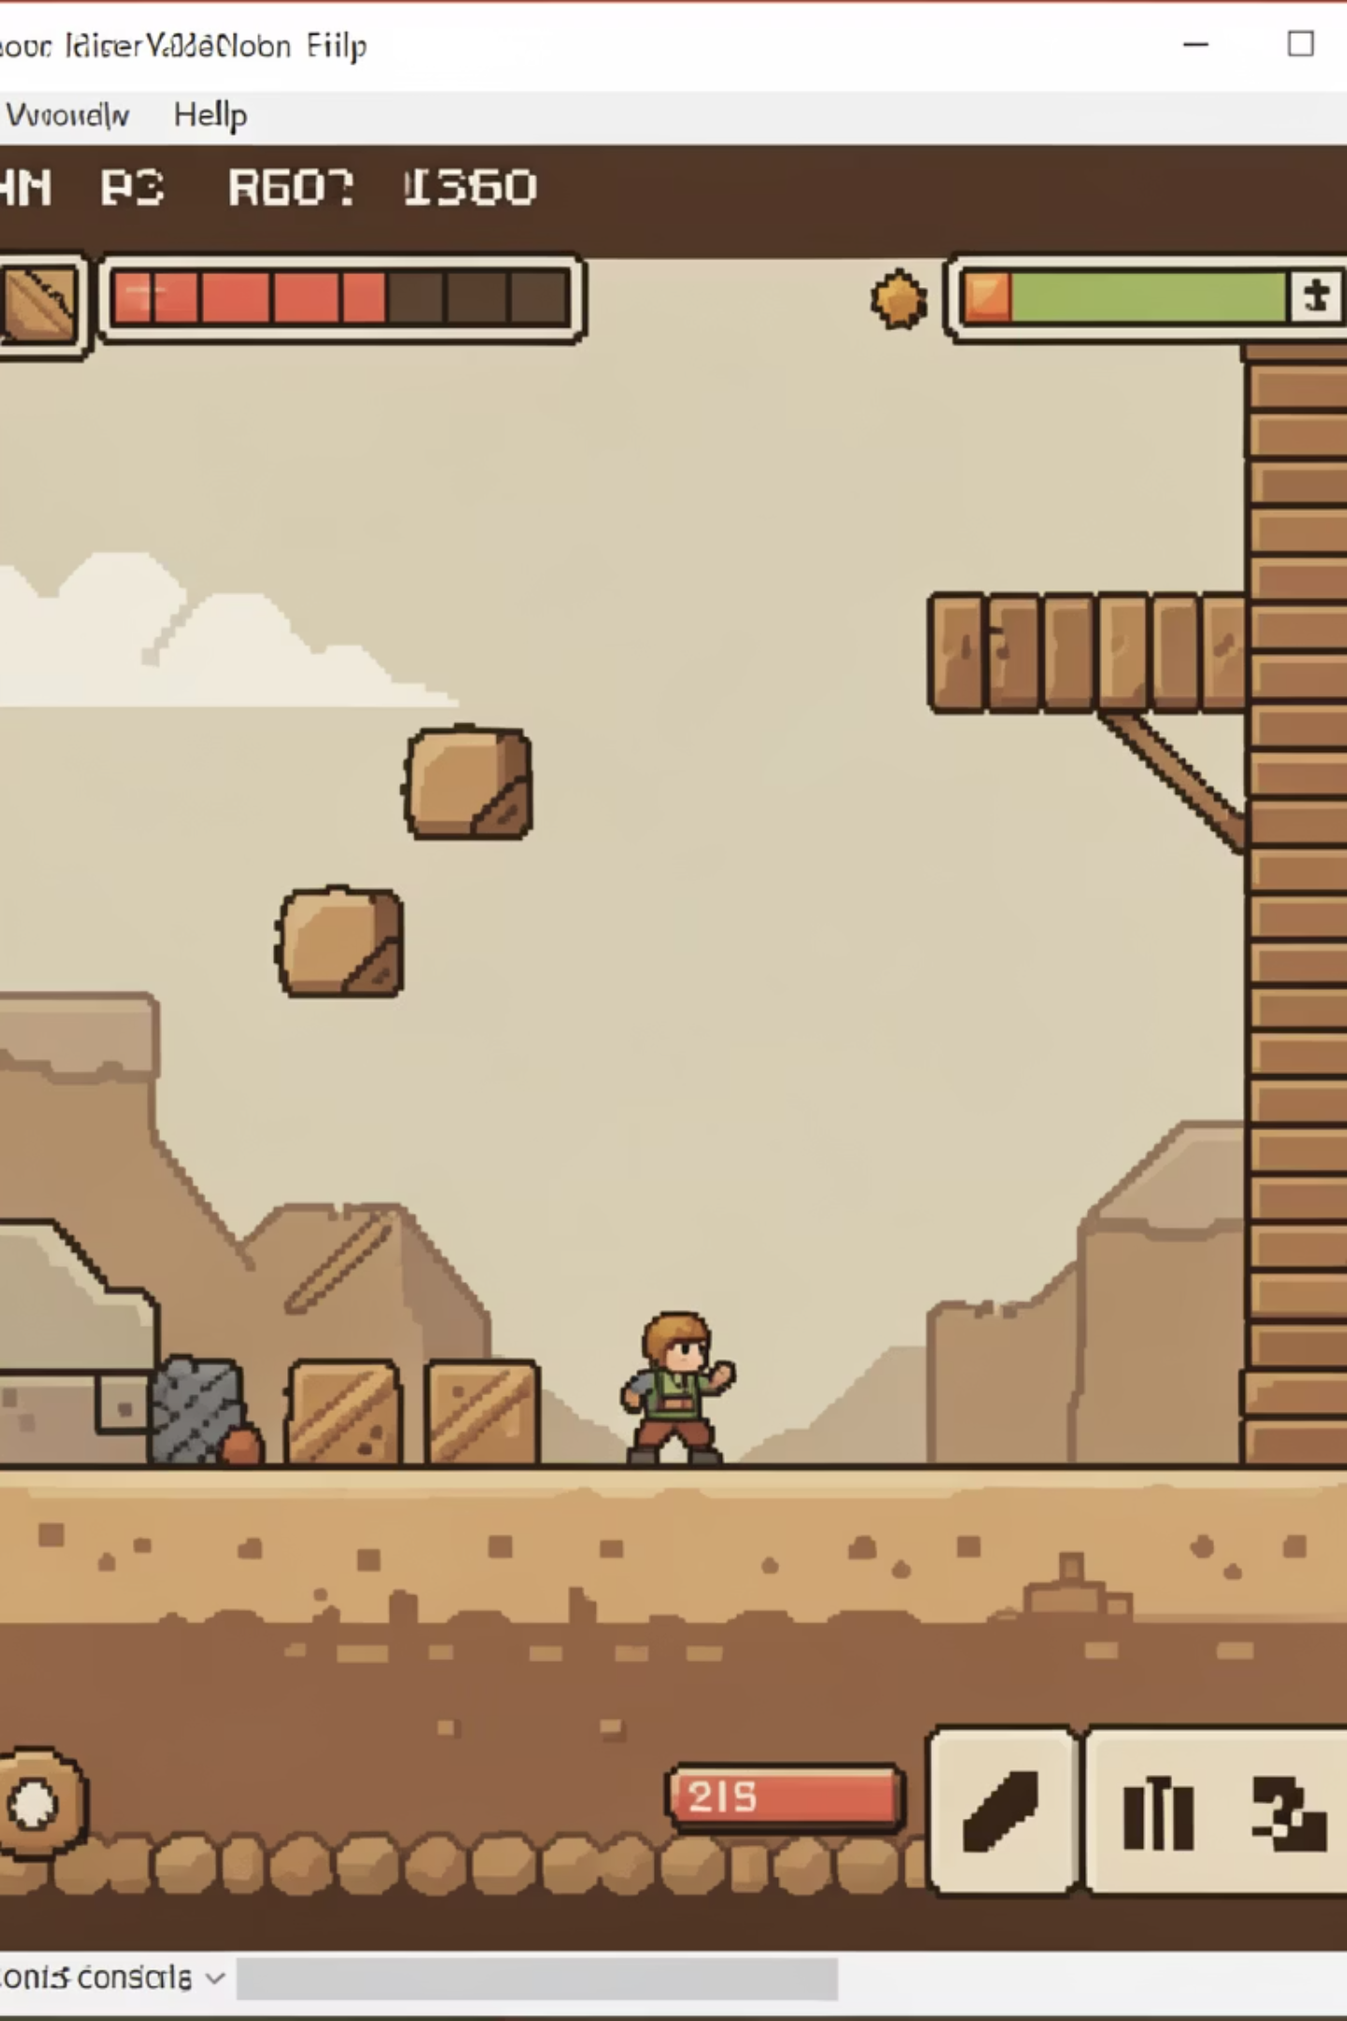



Project Objective
Game Development
Grid Game Logic
Develop a game running entirely within the Ubuntu Terminal.
Implement core Grid Game logic for agent survival.
Agent Survival
Create agents managing resources and avoiding obstacles in random environments.

Slide 3
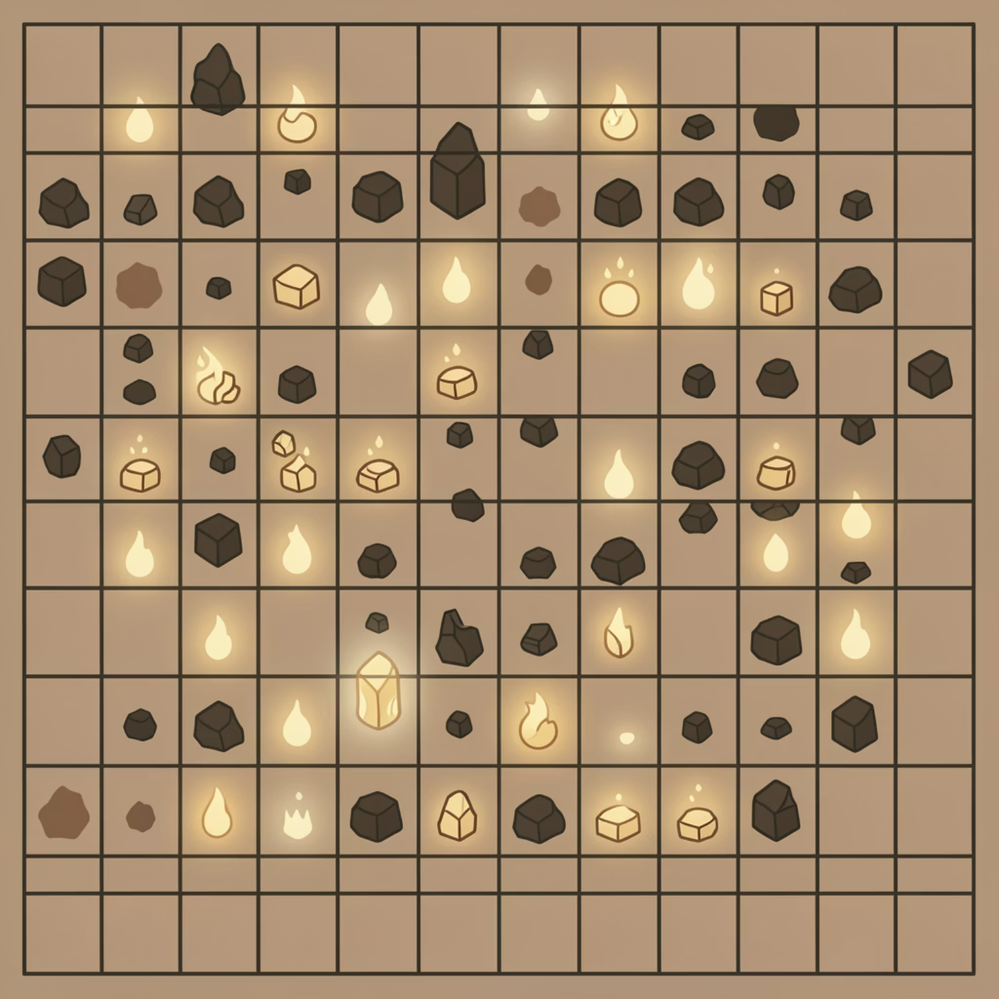
Project Introduction
Project Idea: Core Survival Logic
This project focuses on the mathematical and logical core of survival: an agent navigating a 64x64 grid world to find food and water while avoiding obstacles. Using a CLI emphasizes efficient algorithms and system process management.

Slide 4
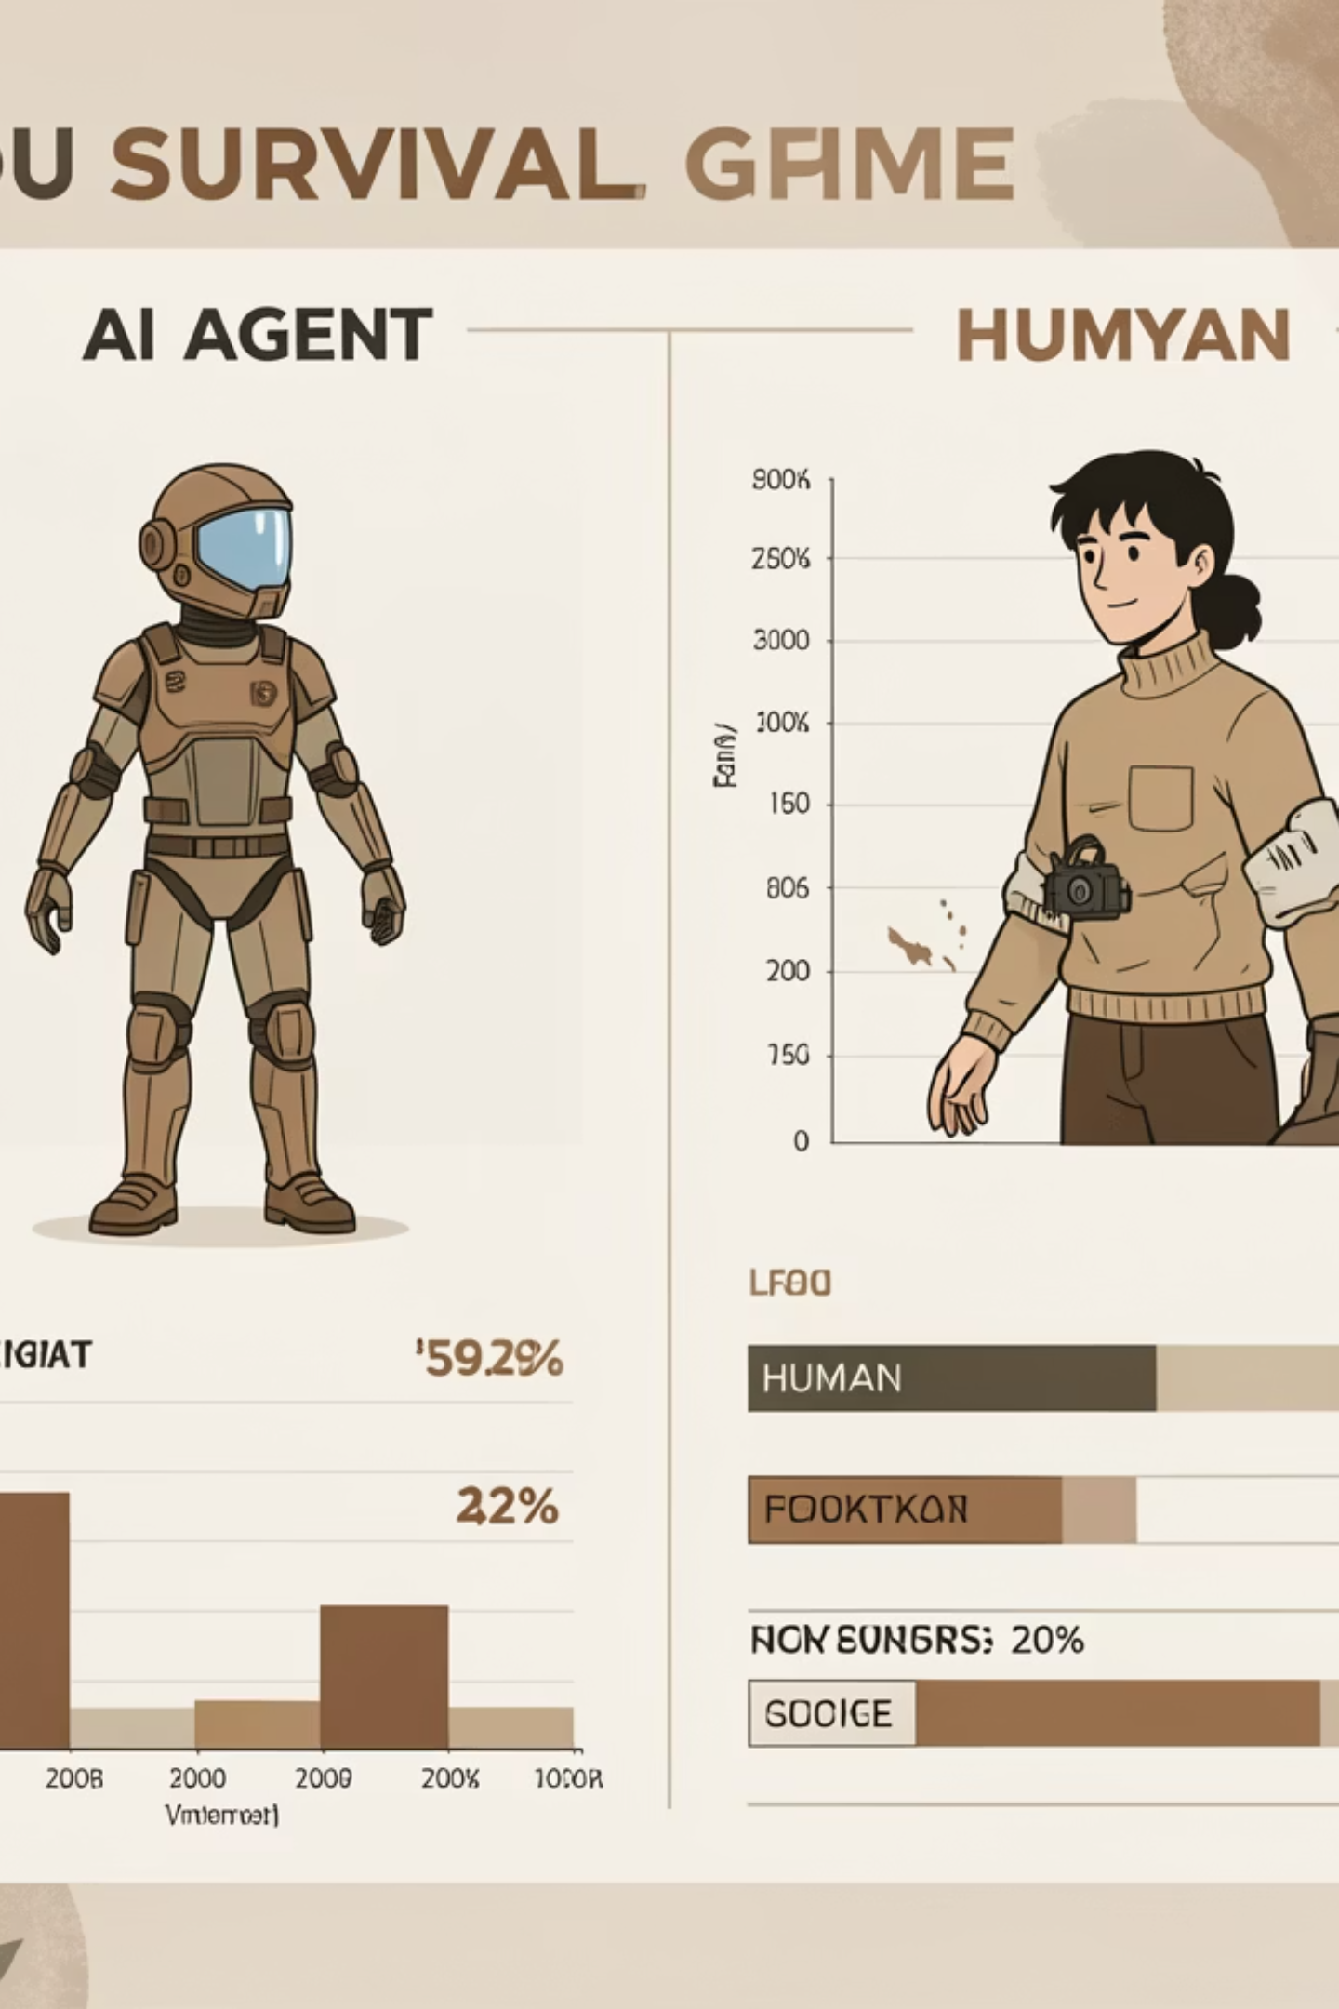
Research Paper Description
This paper defines process survival game environments where the sole objective is to stay alive by finding resources and avoiding hazards. It compares human and AI agent performance, making it relevant for survival game process research.

Slide 5
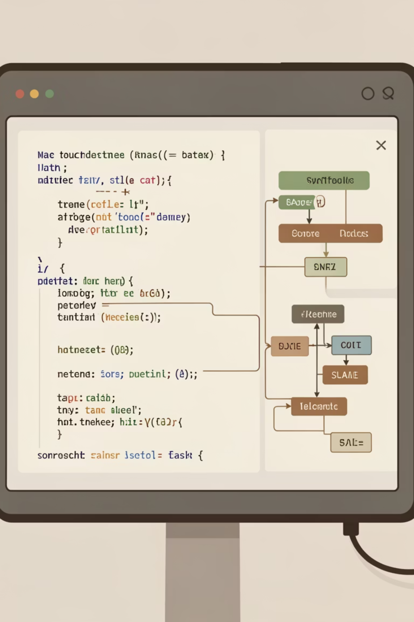




Implementation Strategy
Environment Initialization
Initialize a 64x64 grid on Ubuntu, populating it with randomized food, water, and obstacle coordinates.
Agent Perception
Configure agent perception by extracting a local data window and calculating directional vectors towards resources.
Agent Training
Train the agent using the Proximal Policy Optimization (PPO) algorithm.
Survival Loop Execution
Execute the survival loop in the terminal, outputting resource levels to track the agent's life expectancy.

Slide 6
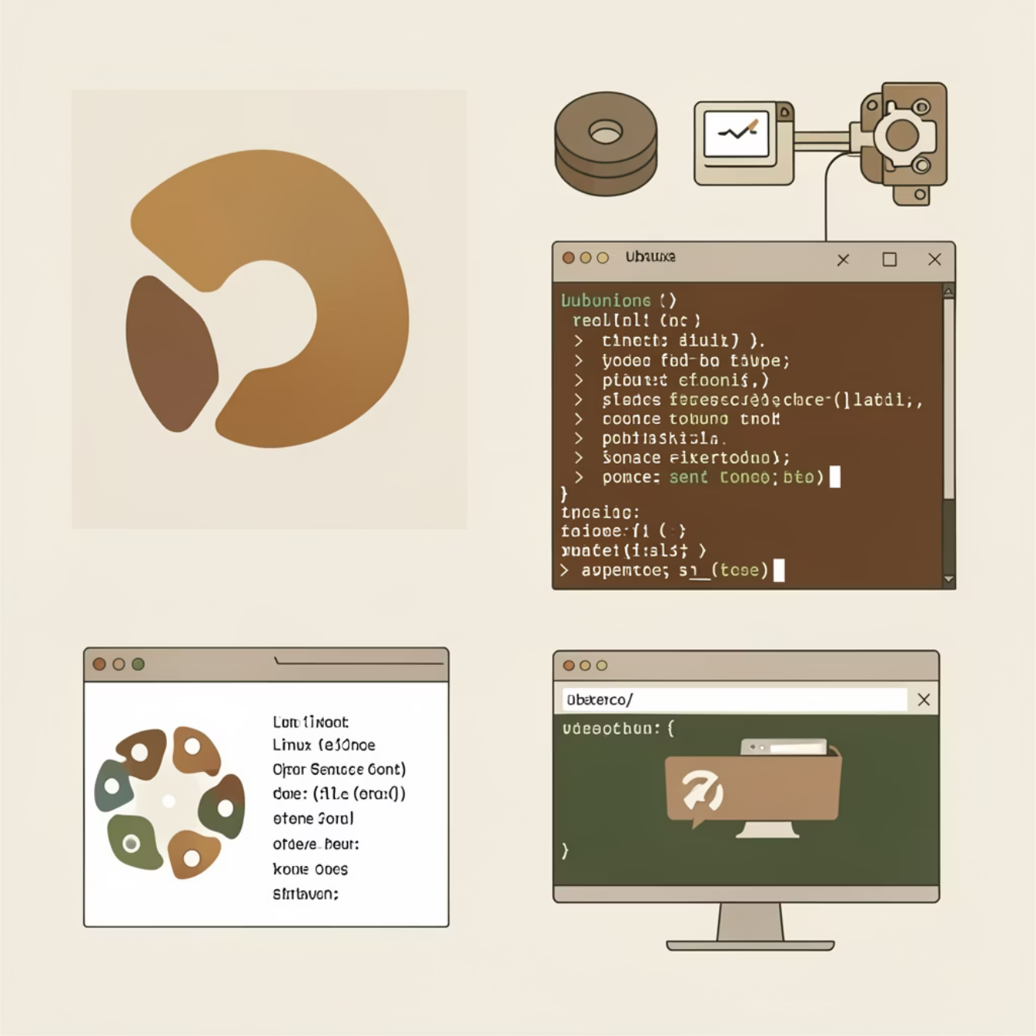
References
Research Paper
Survival Games for Humans and Machines, SSRN Preprint 4587702 (2023). Available at: https://ssrn.com/abstract=4587702.
Operating System
Ubuntu: Our chosen development and testing environment for the project.

